Slide 1

Chapter 6 Session 3
How to use effects and animations
Notes:
Session: Ghi số thứ tự session trong môn học
Session Name: ghi tên của session sẽ dạy

Slide 2
Objectives
How to use effects
A Slide Show application with effects
How to use animation
A Carousel application with animation
Notes:
Mô tả nội dung mà học viên phải đạt được khi kết thúc môn học này

Slide 3
How to use effects
jQuery provide many method to make effect for elements like show(), hide(), slideUp(), slideDown()…
Notes:
Session: Ghi số thứ tự session trong môn học
Session Name: ghi tên của session sẽ dạy

Slide 4
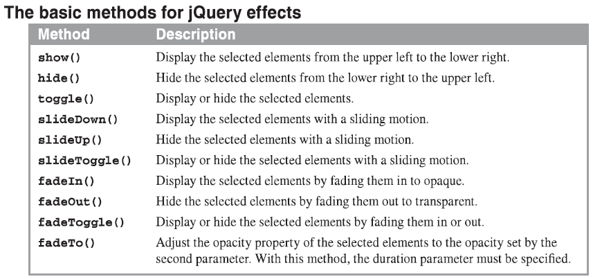
The jQuery methods for effects

Slide 5
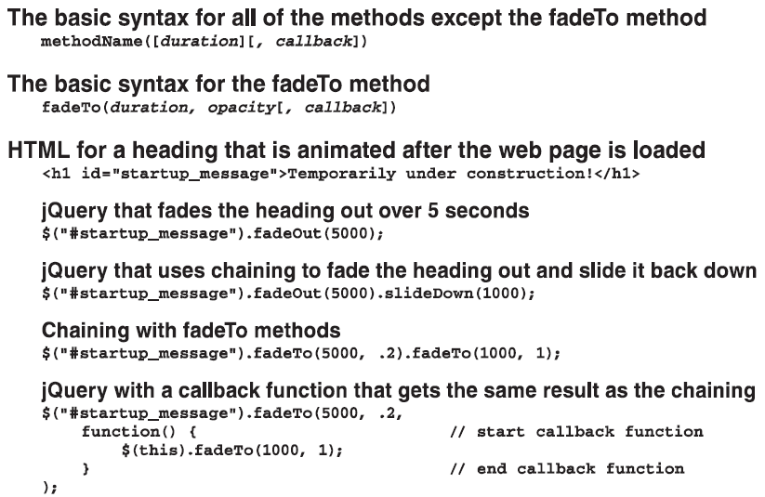
The jQuery methods for effects (cont.)

Slide 6
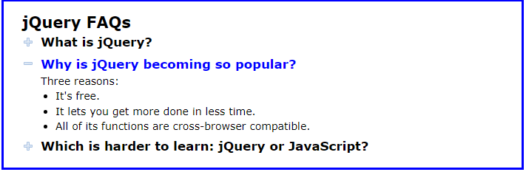
The FAQs application with jQuery effects
The web interface

Slide 7
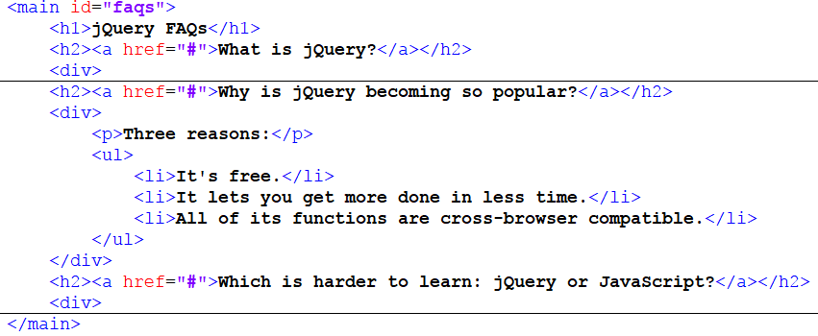
The FAQs application with jQuery effects (cont.)
The HTML code

Slide 8
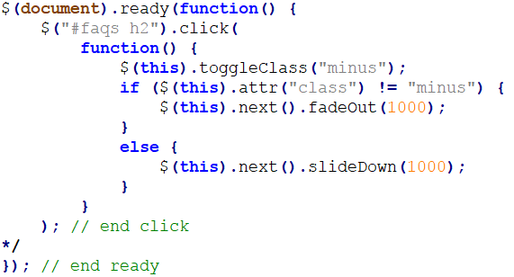
The FAQs application with jQuery effects (cont.)
The jQuery with the slideDown() and fadeOut() methods

Slide 9
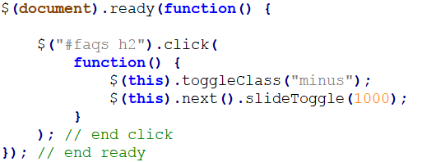
The FAQs application with jQuery effects (cont.)
The jQuery with the slideToggle() methods

Slide 10

A Slide Show application
The web interface

Slide 11
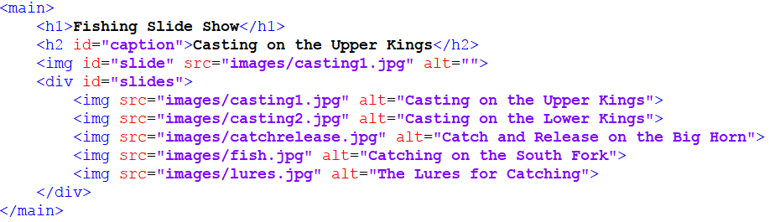
A Slide Show application (cont.)
The HTML code

Slide 12
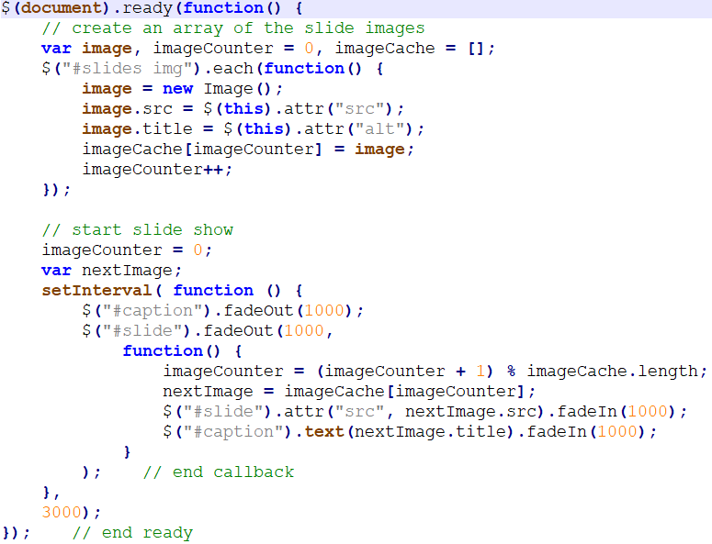
A Slide Show application (cont.)
The jQuery code – The first way

Slide 13
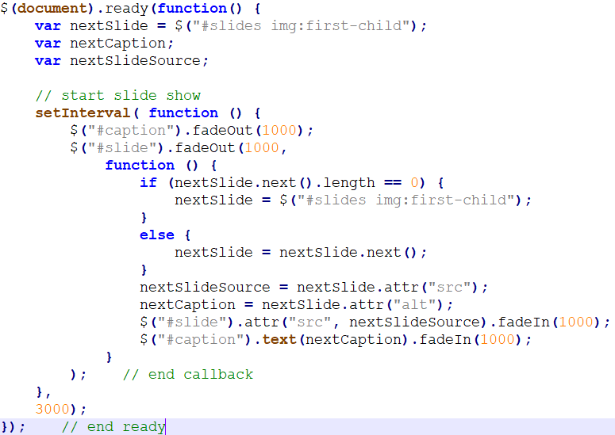
A Slide Show application (cont.)
The jQuery code – The second way

Slide 14
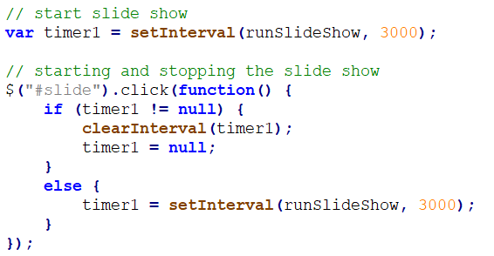
How to stop and start a slide show

Slide 15
How to use animation
This is refer to these custom effects as animation by use animate() method.
Notes:
Session: Ghi số thứ tự session trong môn học
Session Name: ghi tên của session sẽ dạy

Slide 16
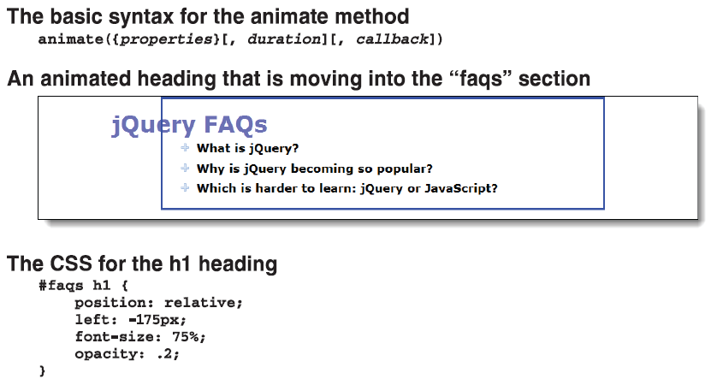
How to use the basic syntax of the animate() method

Slide 17
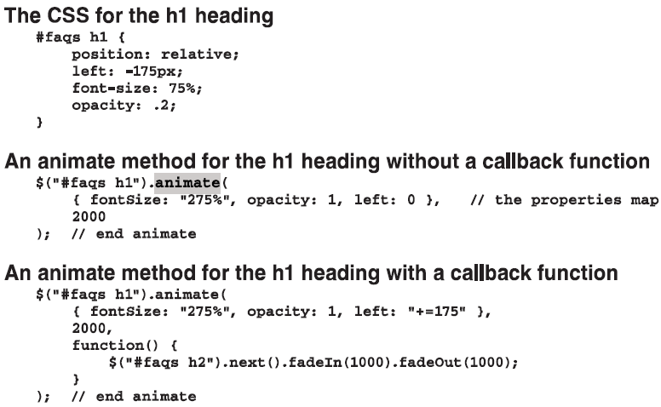
How to use the basic syntax of the animate() method (cont.)

Slide 18
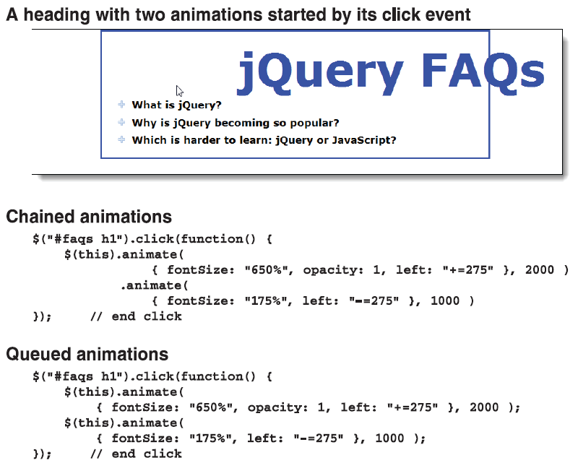
How to chain animate() methods

Slide 19
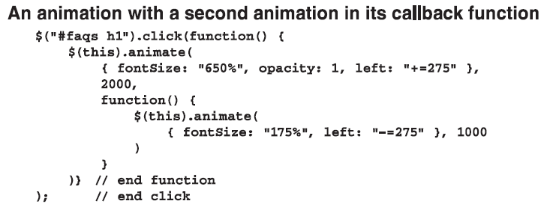
How to chain animate() methods (cont.)

Slide 20
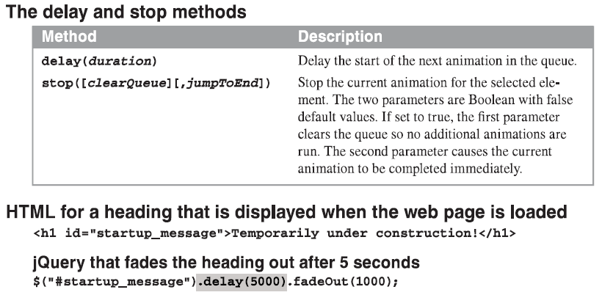
How to use the delay(), stop(), and finish() methods

Slide 21
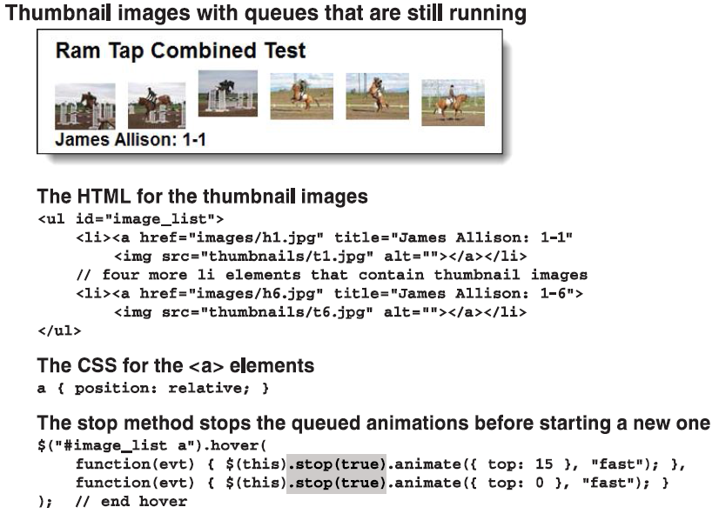
How to use the delay(), stop(), and finish() methods (cont.)

Slide 22
How to use easings with effects and animations
Easing refer to the way an animation is perform.
jQuery provides only two easings: swing and linear.
You can use plugins to get more types of easings.

Slide 23
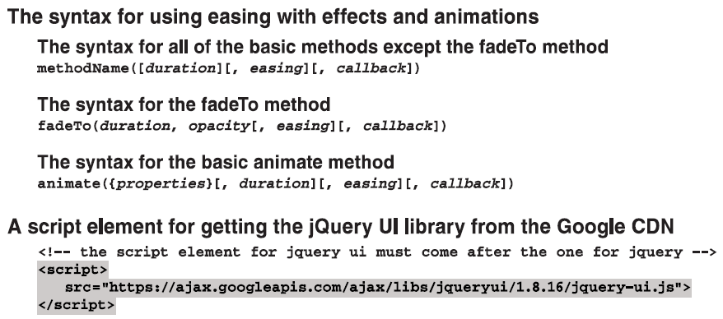
How to use easings with effects and animations (cont.)

Slide 24
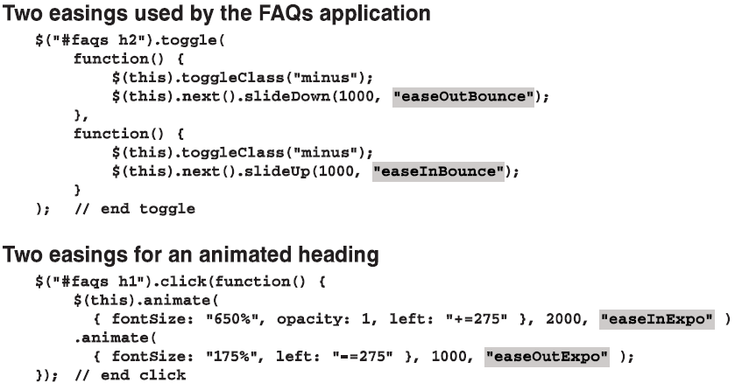
How to use easings with effects and animations (cont.)

Slide 25
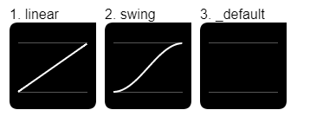
How to use the advanced animate syntax
(selector).animate({styles},{options})
Options : - duration
- easing
- callBack function

Slide 26
A Carousel application with animation
Notes:
Session: Ghi số thứ tự session trong môn học
Session Name: ghi tên của session sẽ dạy

Slide 27
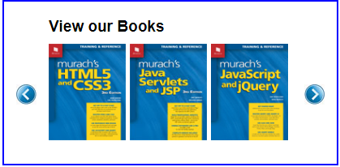
A Carousel application with animation
The web interface

Slide 28
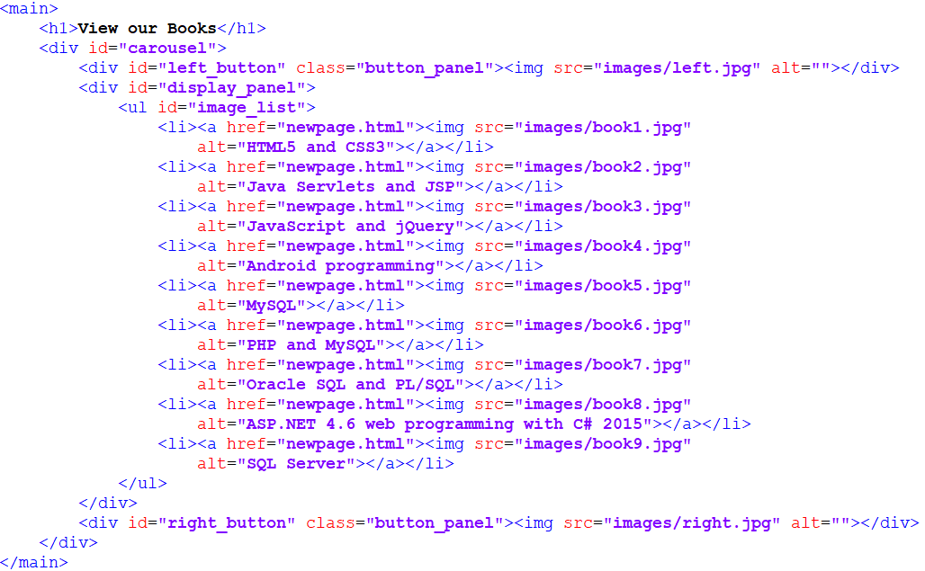
A Carousel application with animation
The HTML code

Slide 29
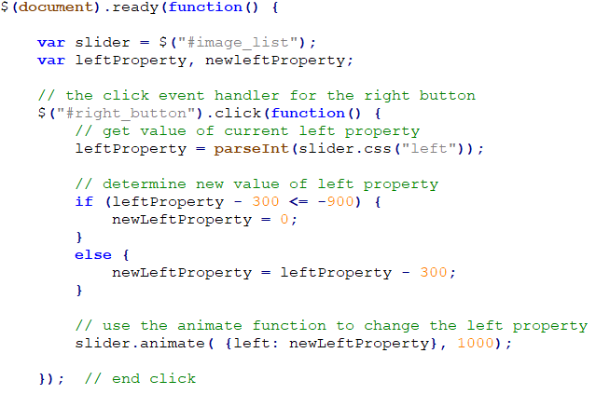
A Carousel application with animation
The jQuery code

Slide 30
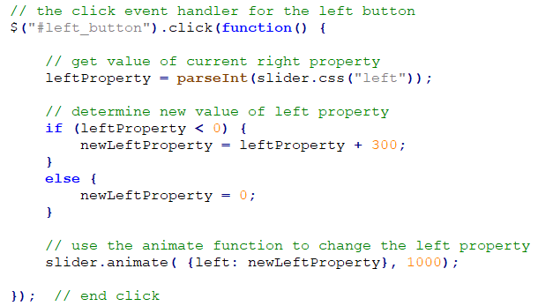
A Carousel application with animation
The jQuery code

Slide 31
Summary
The jQuery provide many method to make effect for elements like show(), hide(), slideUp(), slideDown()…
The jQuery animation is refer to these custom effects as animation by use animate() method.
Easing refer to the way an animation is perform. The jQuery provides only two easings: swing and linear.

Slide 32
The End.

